Slide 1
Mapping population from voters listing in Niger

Slide 2
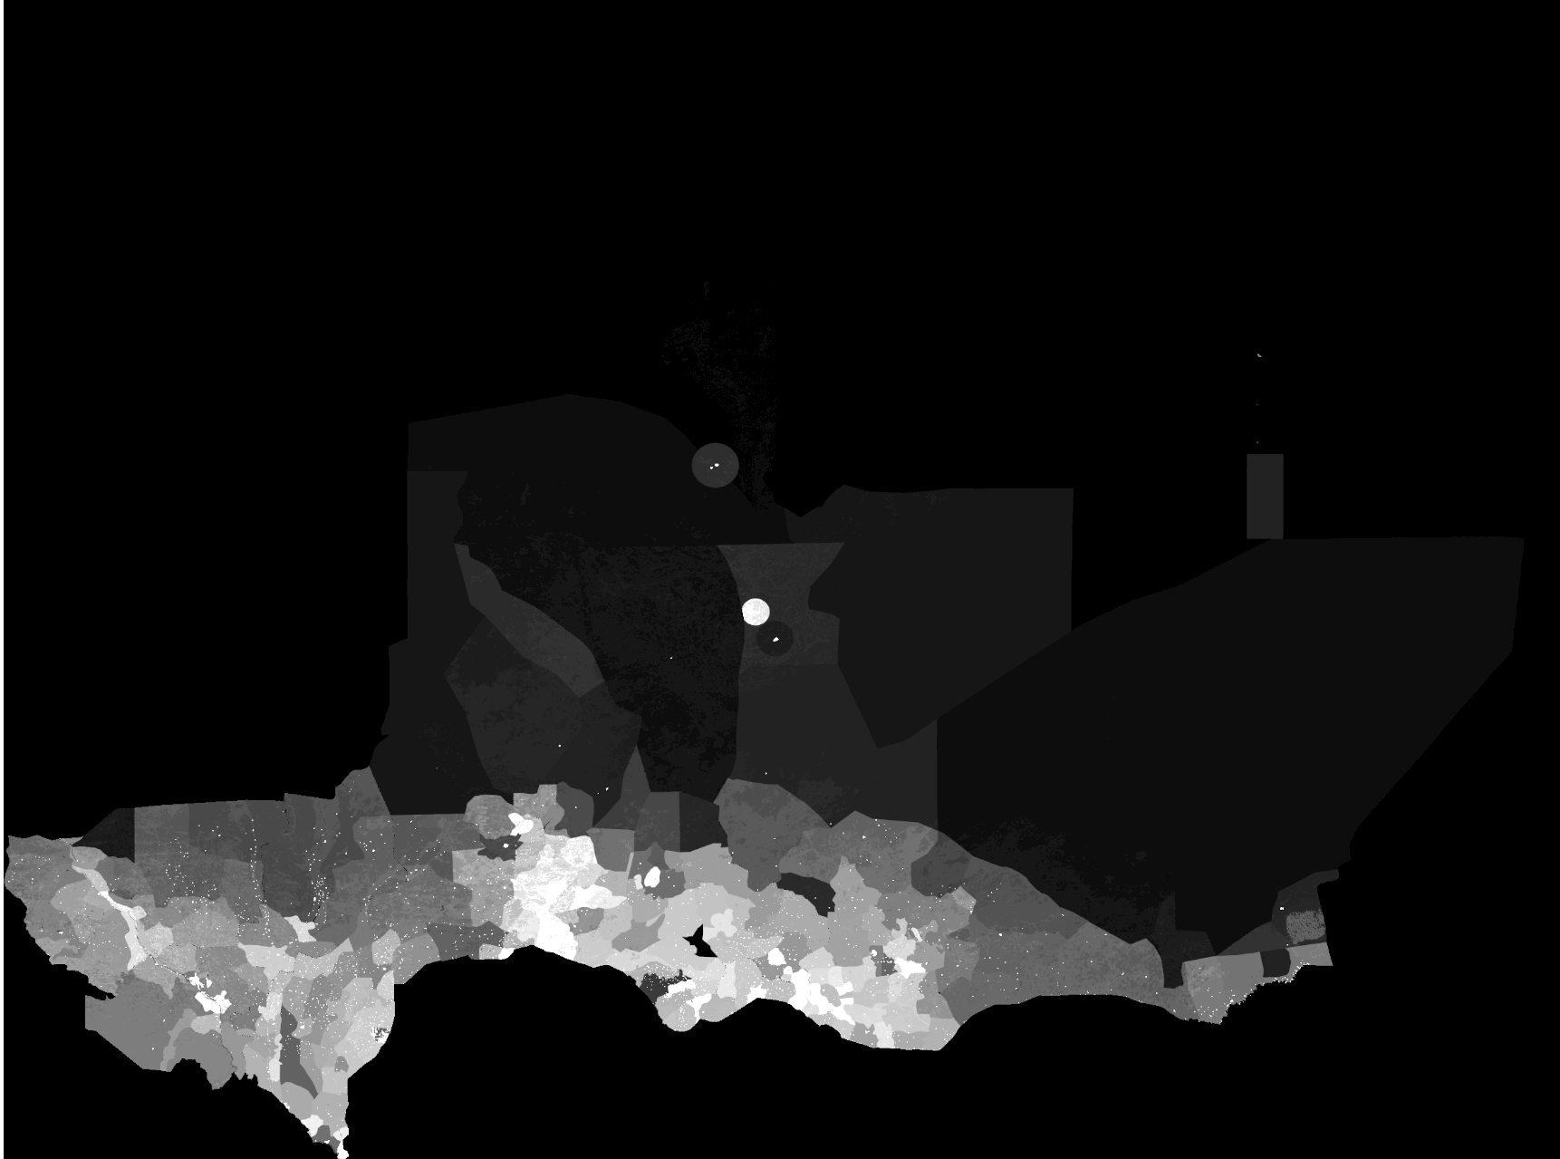
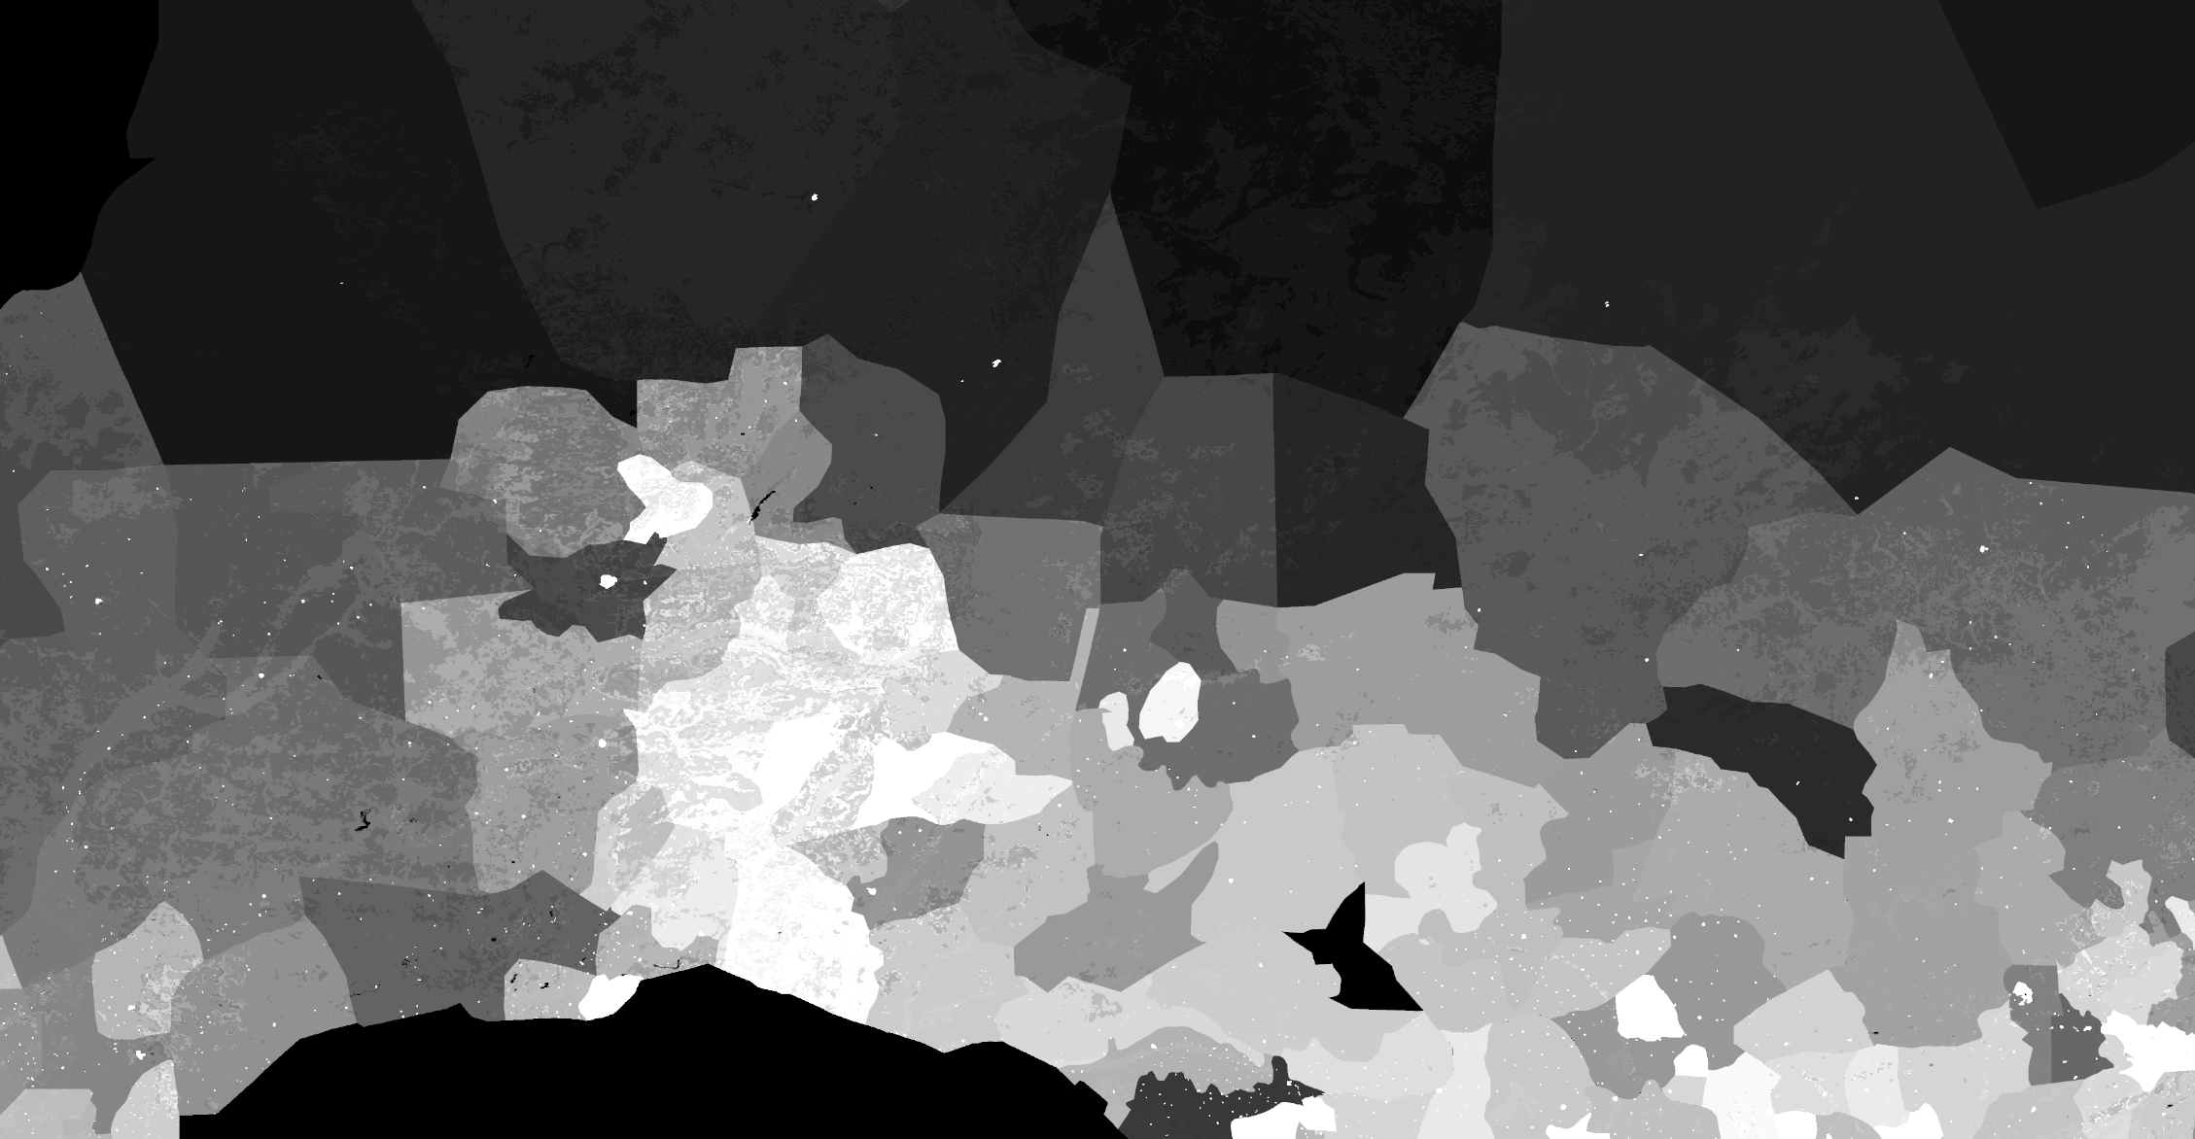

State of the art
Hardly actionable for project planning or logistics
Updated based on census (~ every 10 years)
Index map on place name
Updated ~ every 5 years

Slide 3
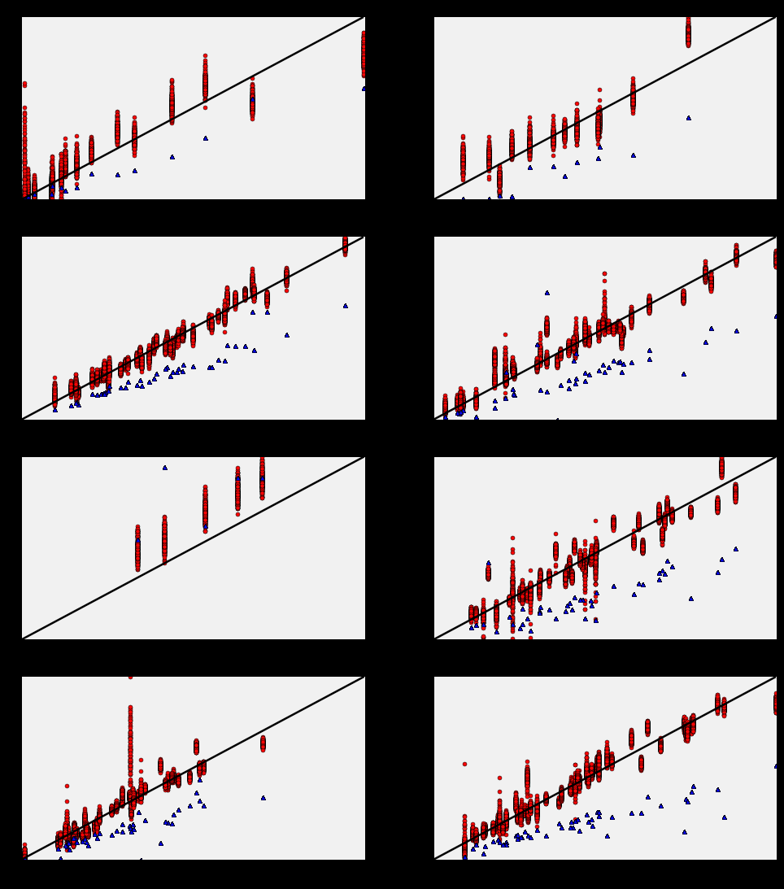
To do
Extrapolate data for full population
Impute age distributions
Match different writings of same locations + map
Point surround distribution
Dashboard for end user

